Slide 1
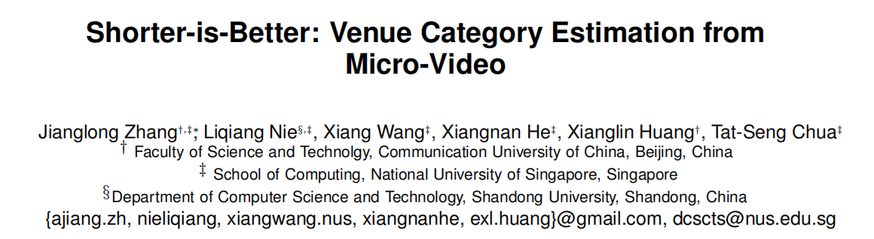

Slide 2
Aim to label the bite-sized video clips with venue categories
Crawl a representative set of micro-videos from Vine and extract a rich set of features from textual, visual and acoustic modalities.
Build a tree-guided multi-task multi-modal learning model to estimate the venue category for each unseen micro-video.

Slide 3
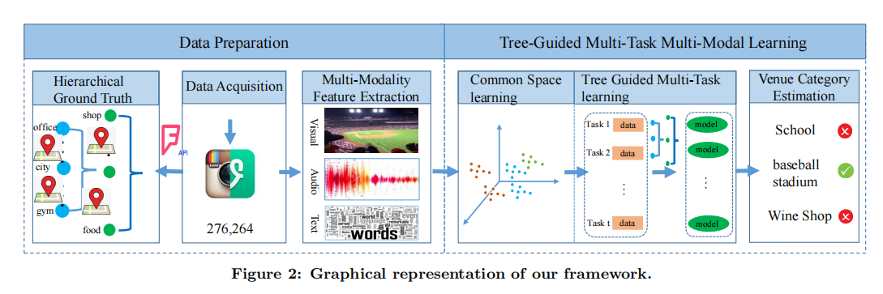

Slide 4
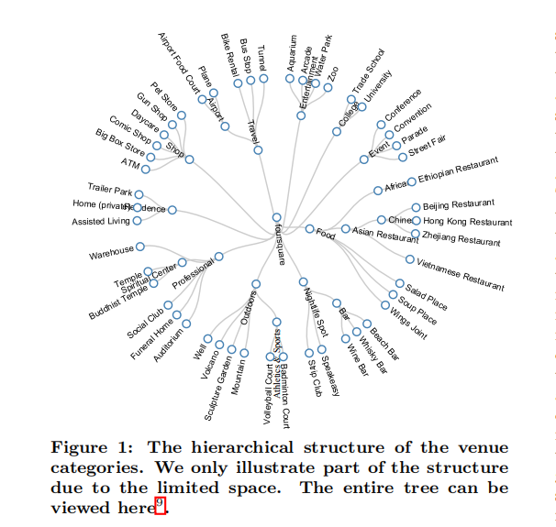
Ground Truth Construction

Slide 5
Multi-Modality Feature Extraction
Features in Visual Modality
Extract the key frames from each micro-video by using OPENCV
Employee the AlexNet to get CNN features of each frame.
Take the mean pooling strategy over all the key frames of one video, and generated a single 4,096 dimensional vector for each micro-video.
Features in Acoustic Modality
Separate audio tracks from micro videos with the help of Ffmpeg
Perform a spectrogram with a 46ms window and 50% overlap via librosa, getting the shallow representation of each audio track with 512 dimensional features
Employee stack Denosing AutoEncoder to obtain 200 dimensional acoustic features for each micro-video

Slide 6
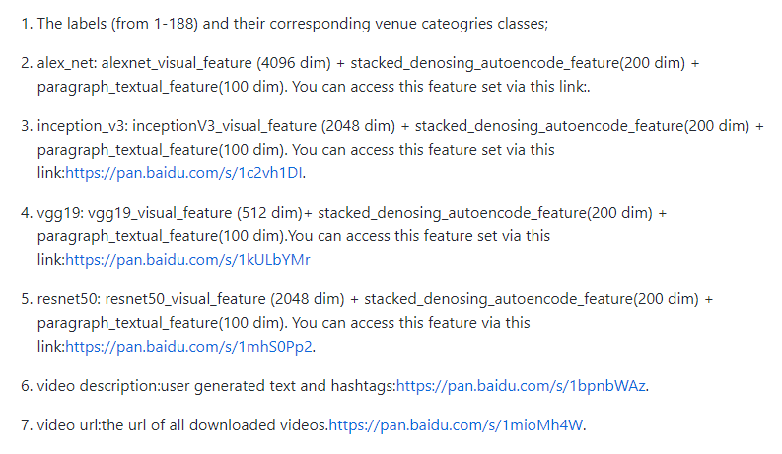
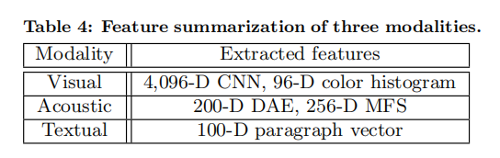
Multi-Modality Feature Extraction
Features in Textual Modality
Eliminate the non-English characters, followed by removing the stop words
Employee Sentence2Vector tool to extract 100 dimensional features for each micro-video description.

Slide 7
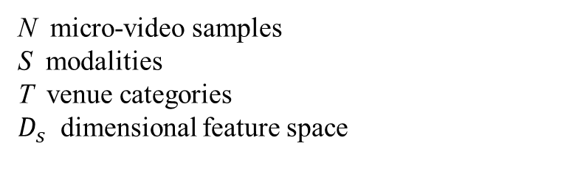
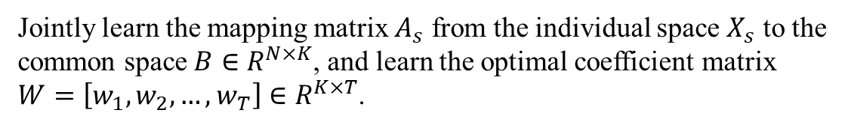
Notations
N micro-video samples
S modalities
T venue categories
$D_{s}$ dimensional feature space
Object
Jointly learn the mapping matrix $A_{s}$ from the individual space $X_{s}$ to the common space $B∈R^{N×K}$, and learn the optimal coefficient matrix $W=\left[w_{1},w_{2},…,w_{T}\right]∈R^{K×T}$.

Slide 8

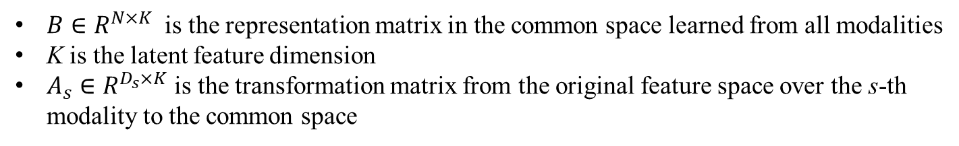
Common Space Learning
$B∈R^{N×K}$ is the representation matrix in the common space learned from all modalities
K is the latent feature dimension
$A_{s}∈R^{D_{s}×K}$ is the transformation matrix from the original feature space over the s-th modality to the common space

Slide 9




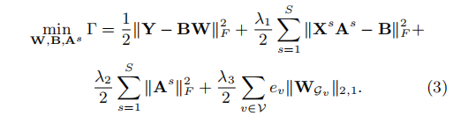
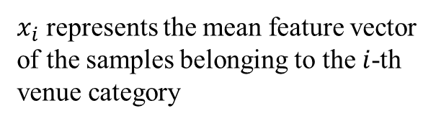
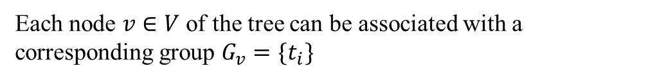
Tree-guided Multi-task Learning
Task Relatedness Estimation
Relatedness among different tasks can be characterized by a tree τ with a set of nodes V
Each node $v∈V$ of the tree can be associated with a corresponding group $G_{v}=\{t_{i}\}$
$x_{i}$ represents the mean feature vector of the samples belonging to the $i$-th venue category

Slide 10
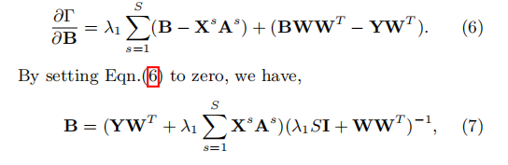
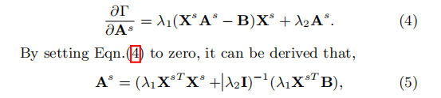

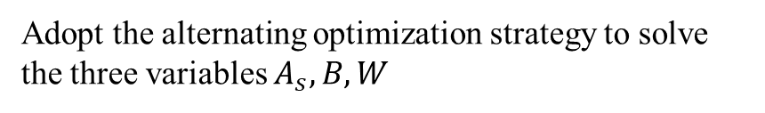

Optimization
Adopt the alternating optimization strategy to solve the three variables $A_{s},B,W$
Computing $A_{s}$ with $B$ and $W$ fixed
Computing $B$ with $A_{s}$ and $W$ fixed
$$\frac{∂Γ}{∂A^{s}}{=λ}_{1}{X^{s}}^{T}\left(X^{s}A^{s}−B\right)+λ_{2}A^{s}$$

Slide 11

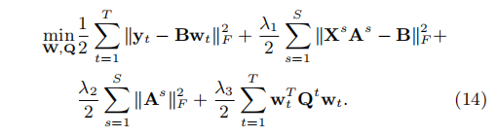
Computing $W$ with $A_{s}$ and $B$ fixed

Slide 12
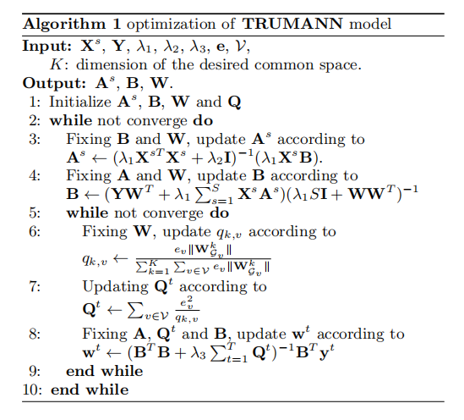

Slide 13
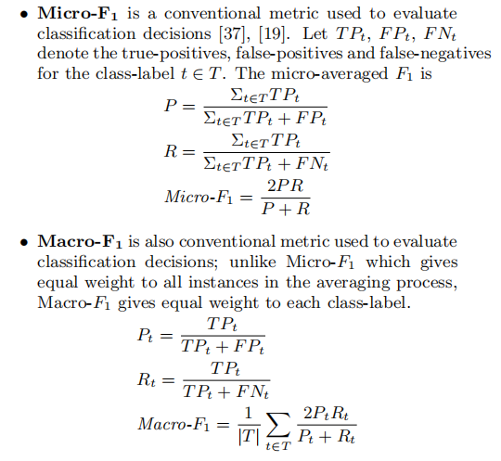
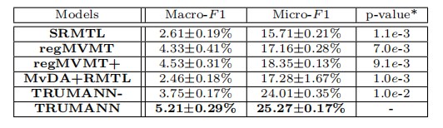
Metrics
Results

